Slide 1
EDA of “British Airways” Reviews

Slide 2
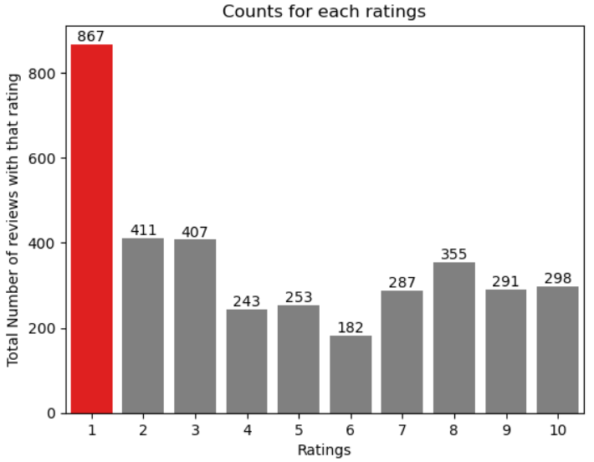
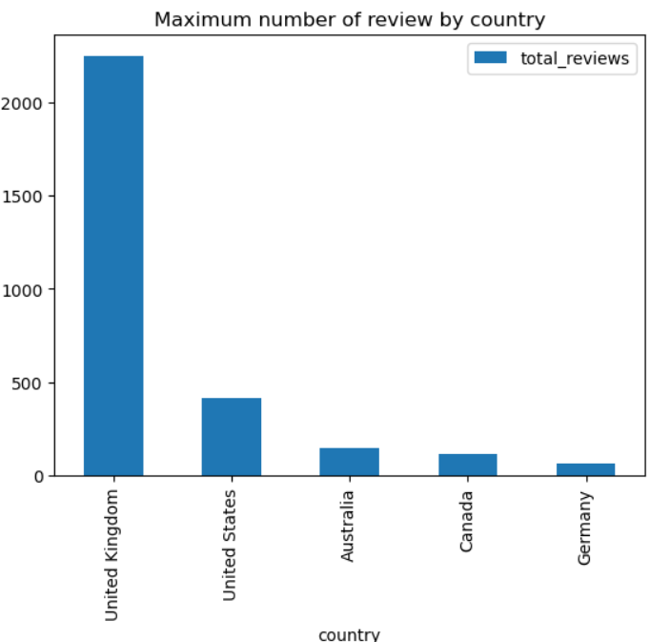

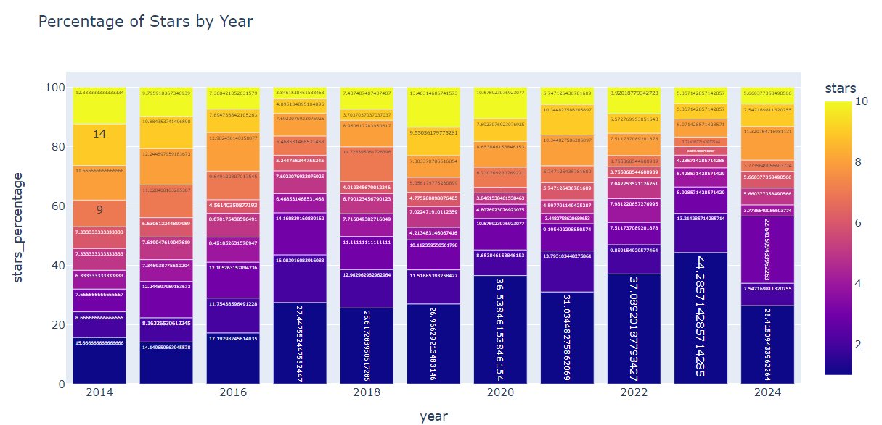

Avg Rating : 4.64 / 10
Number of Unique countries : 70

